Slide 1
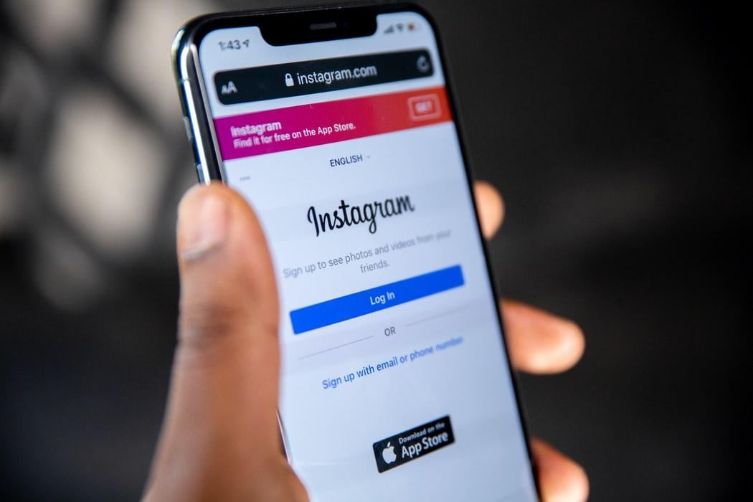
Instagram
INFO6150 - Web Design Final Project
Social Media App Using MERN Stack Product Development
Team-8 Presentation

Slide 2



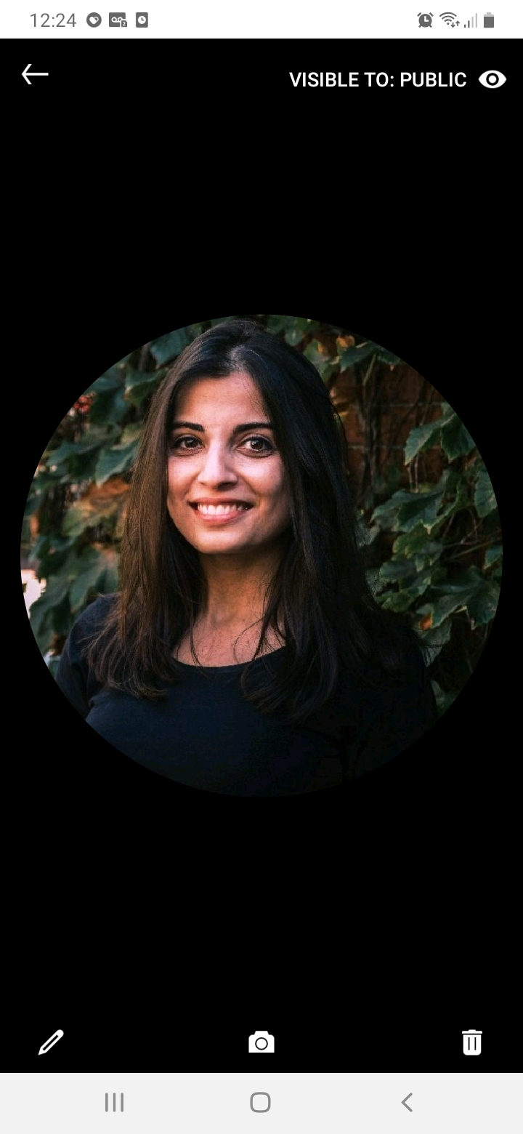
Team Introduction
Hemant Jain
jain.he@northeastern.edu
Sagar Shah
shah.sagar@northeastern.edu
Sapna Patel
patel.sap@northeastern.edu
Keerti Ojha
ojha.ke@northeastern.edu

Slide 3
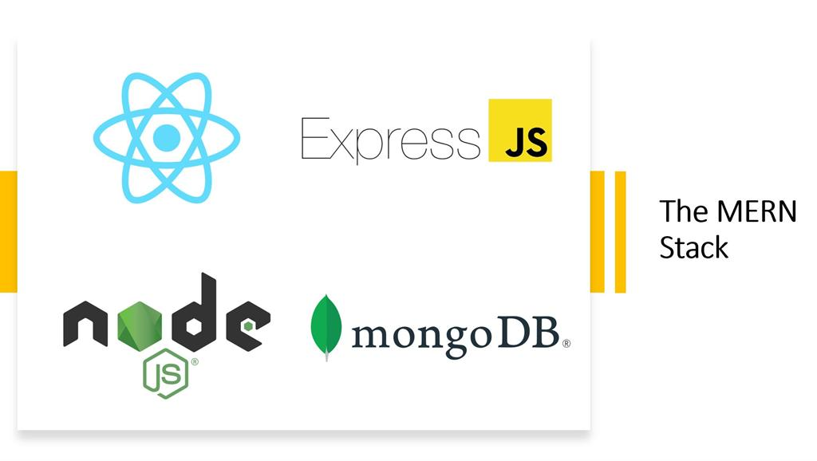
Technology Stack Used for Project
Frontend: React
State management: Redux
Routing: React Router
Animations: React Spring
Websocket management: Socket.io
Backend: Express
Database: MongoDB
Image hosting: Cloudinary
GitHub Auth: Token

Slide 4
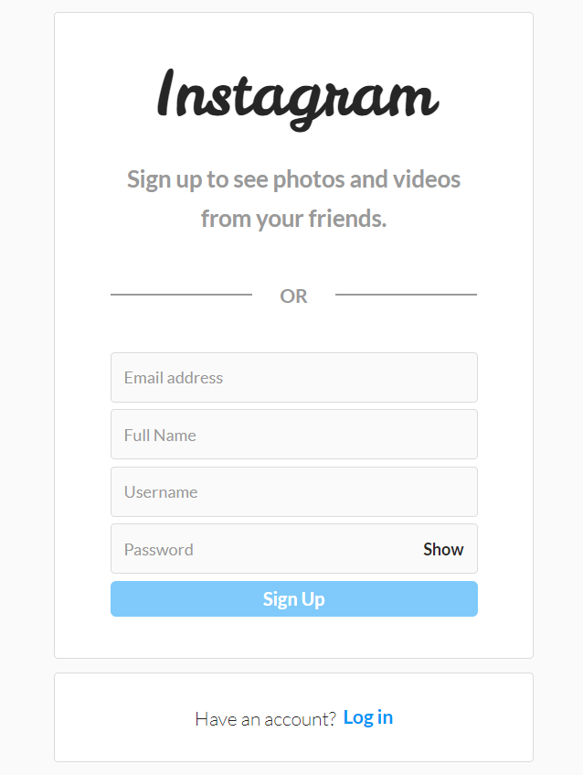
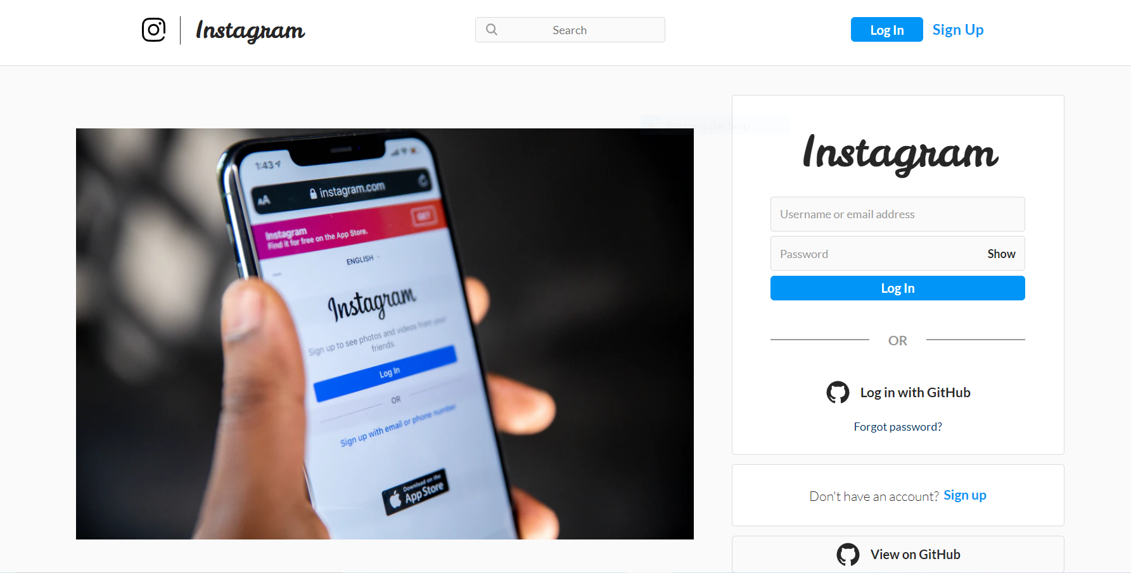
Login/signup
User can create new account through signUp and login with username and password
Perform Token based Authentication using JWT token

Slide 5
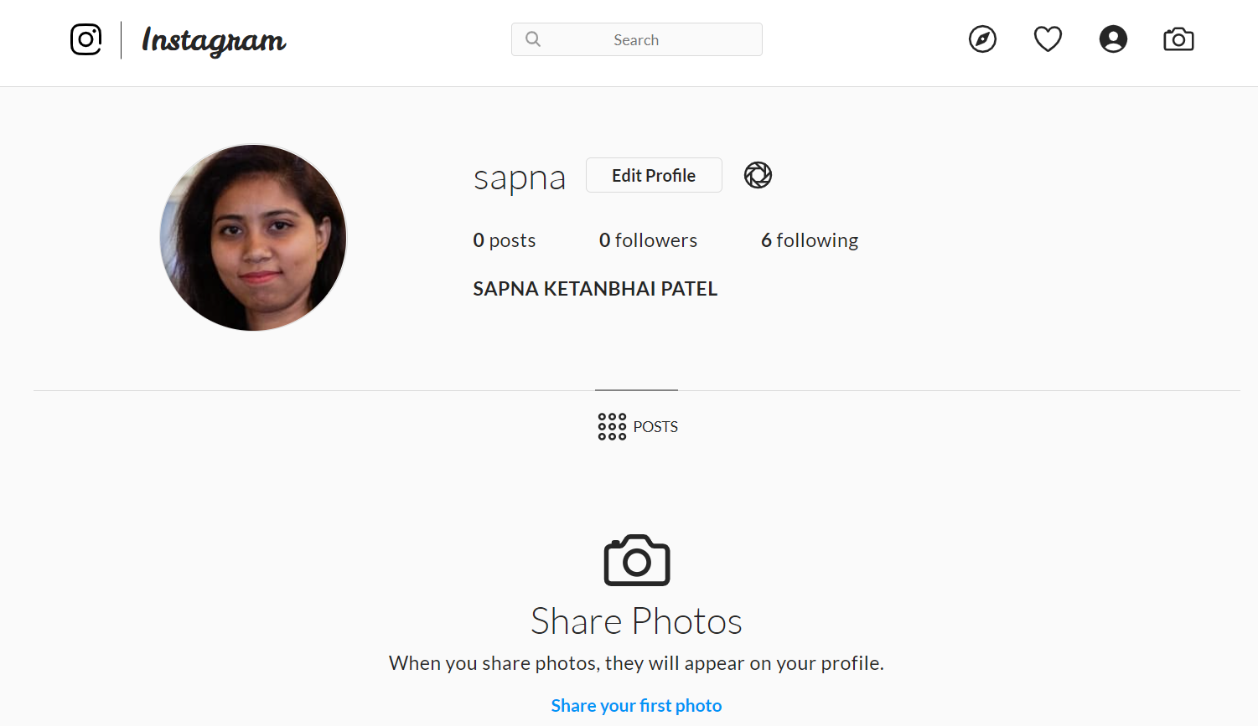
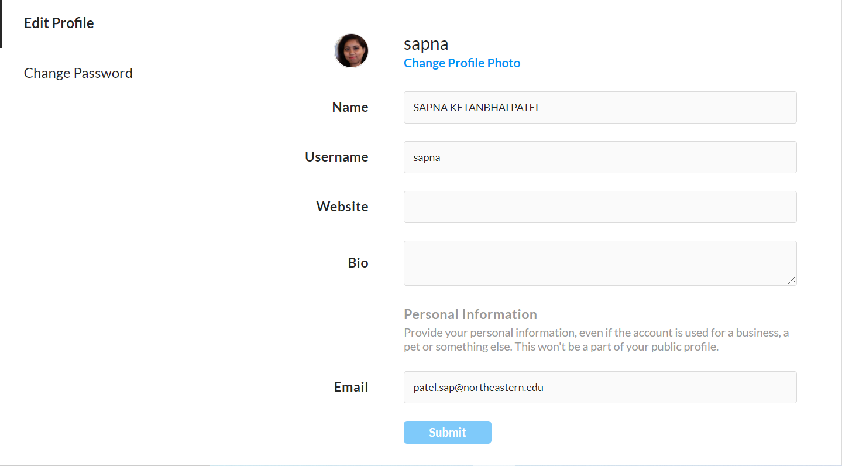
User Profile feature
User profile
Edit Profile feature allow user to change various fields like profile photo and password.
Implemented user profile feature, user create their profiles with profile picture, username,bio and website.

Slide 6
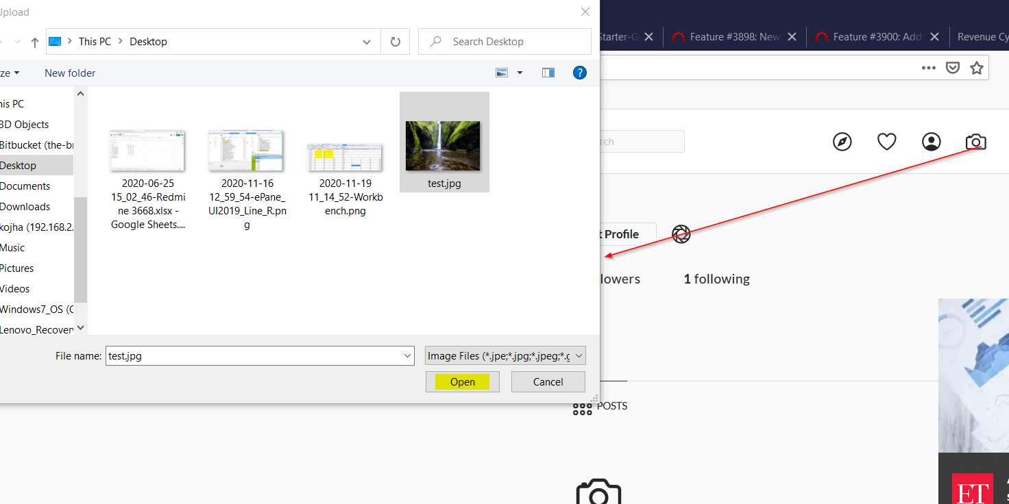
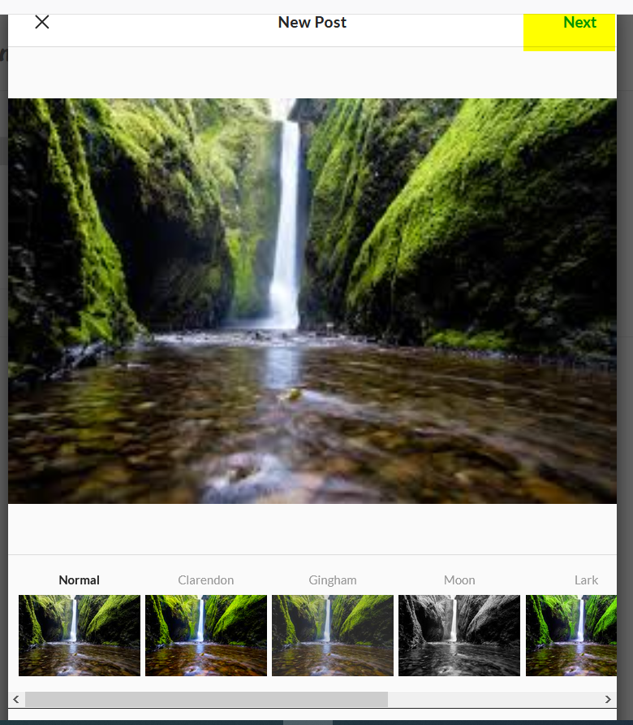
New post filters
Implemented minimal list user experience to update personal feeds along with different filters and saving on database using asynchronous request
Filters are rendered with the help of configurable json object from backend api layer

Slide 7
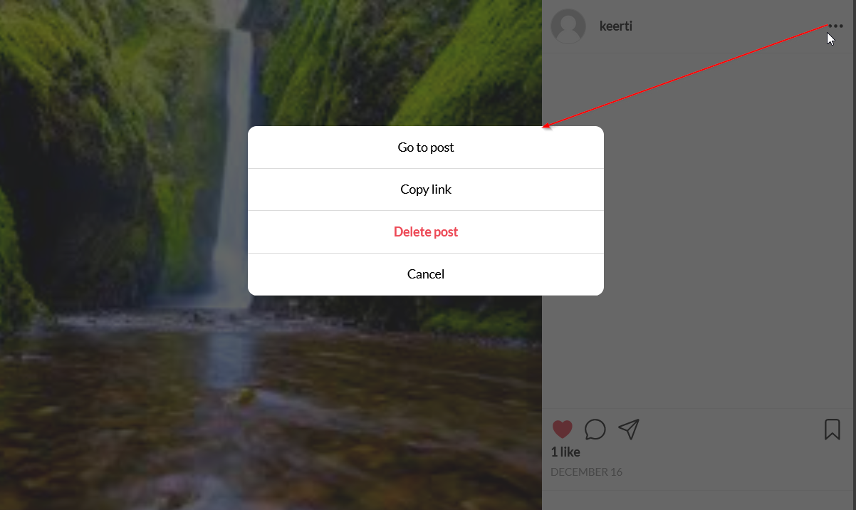

Likes are implemented with the help of redux store along with backend api layer to maintain the current state of application
Features like delete post and cancel post are implemented on PostDialog Actions
Post Vote and Delete Post

Slide 8
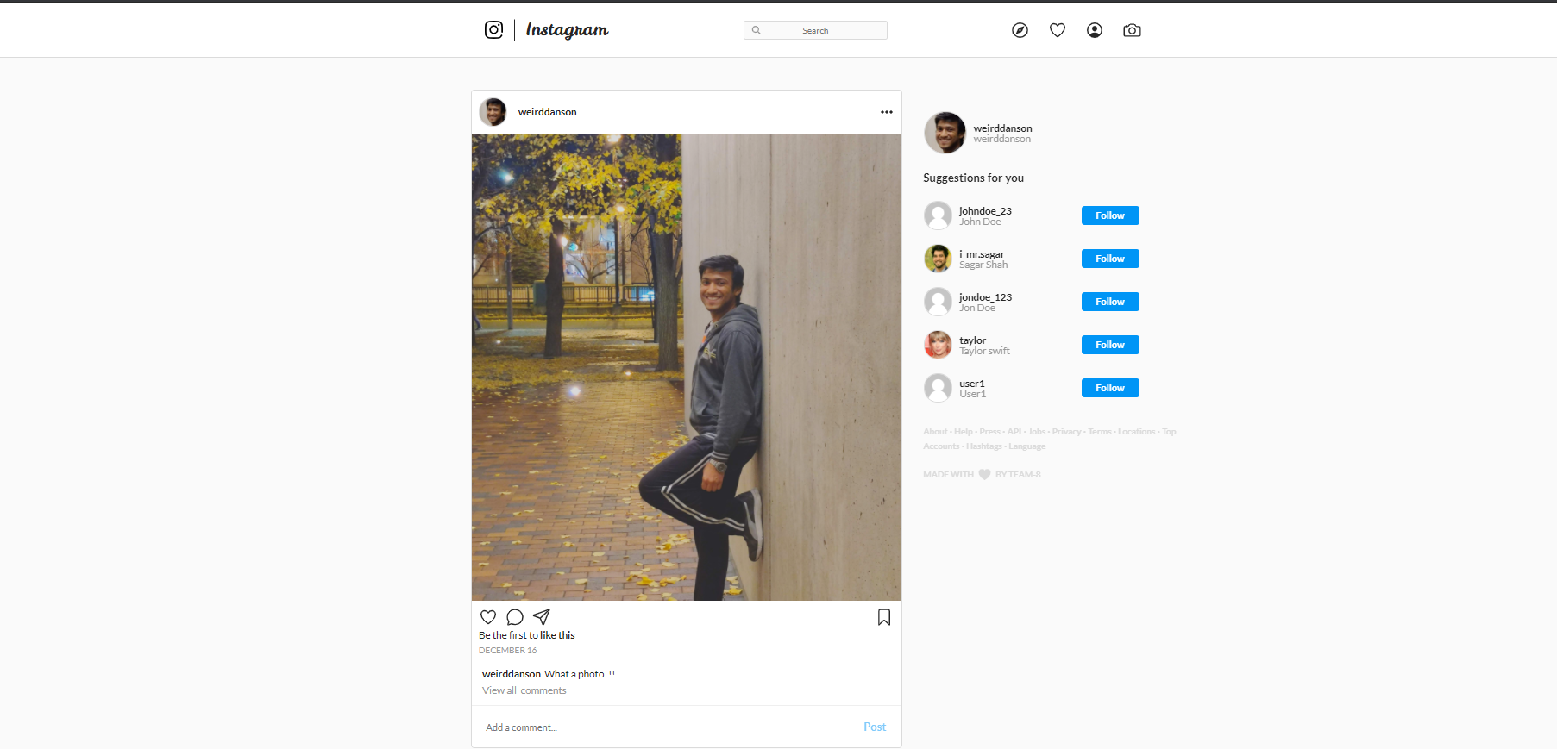
Instagram Post Feature
Implemented the New Post Image Upload feature with async. Call to the Controller in the backend allowing multiple users to post simultaneously and be updated with all the New Feeds.
Real-Time User Feed and Suggestions of other people to follow and Like and Comments feature as well is being added.
Personal Profile Photo and Post
Suggestion Box
Like/Comment Tags

Slide 9
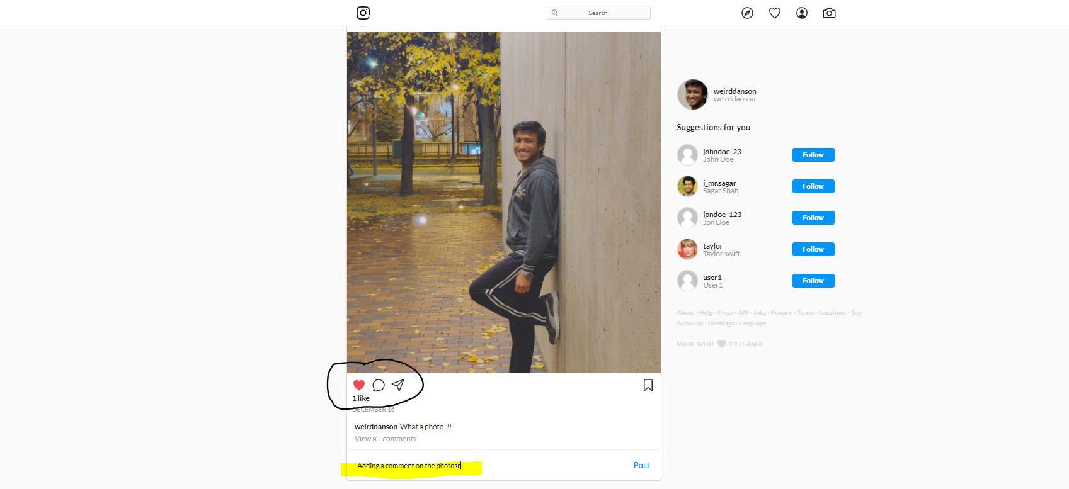
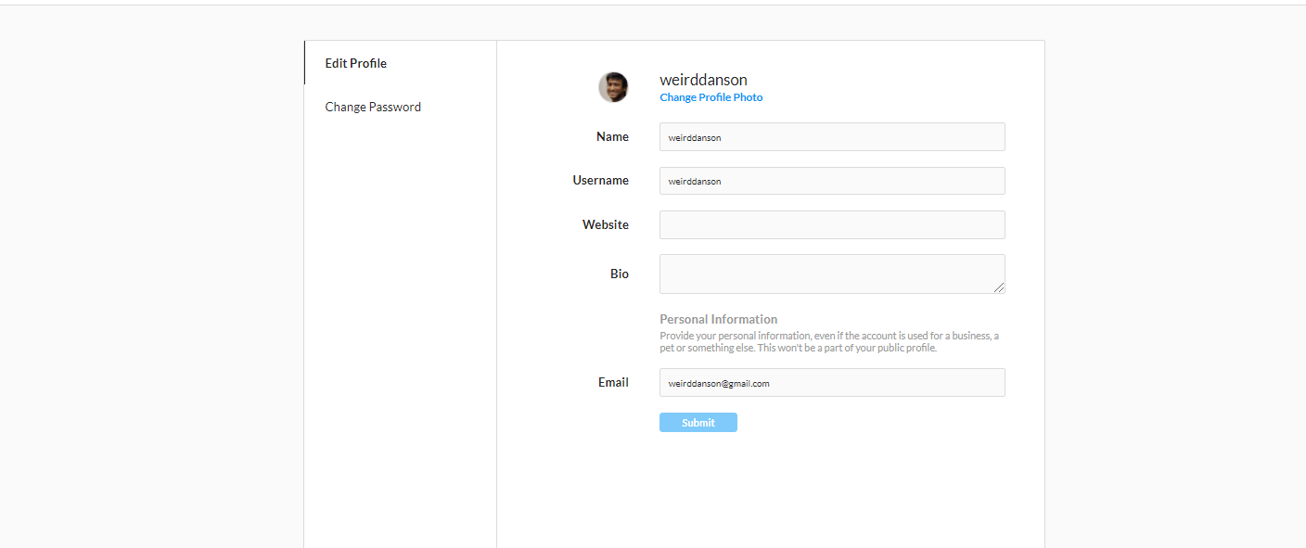
Adding Instagram Comment and Like/DisLike Feature
Implemented the User Accessible Authorized Mode Like and Comment Feature; allowing only authenticated users to login and view the profile of someone else and follow and comment on their new post.
Settings to Update Profile
Updating Like Button

Slide 10
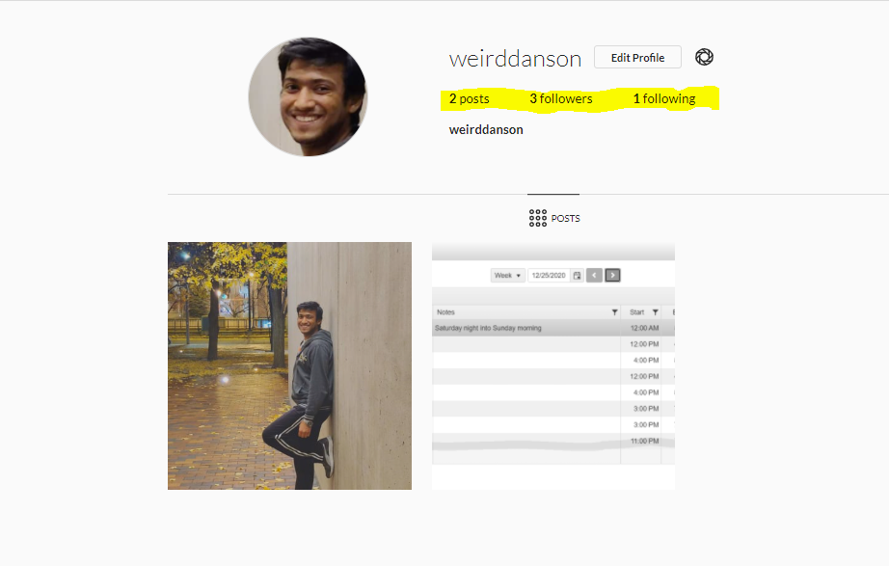
Instagram Followers,Follow,Post Counts
Implemented the real-time authorized and authenticated user-count increments for the followers and to-do follow pages in the Instagram Feed.
Outlined the complete design pages in the React-Redux Frontend library for the User-Interactive screens for easy visualization and communication between users
Update for number of posts, followers and following pages and users.

Slide 11
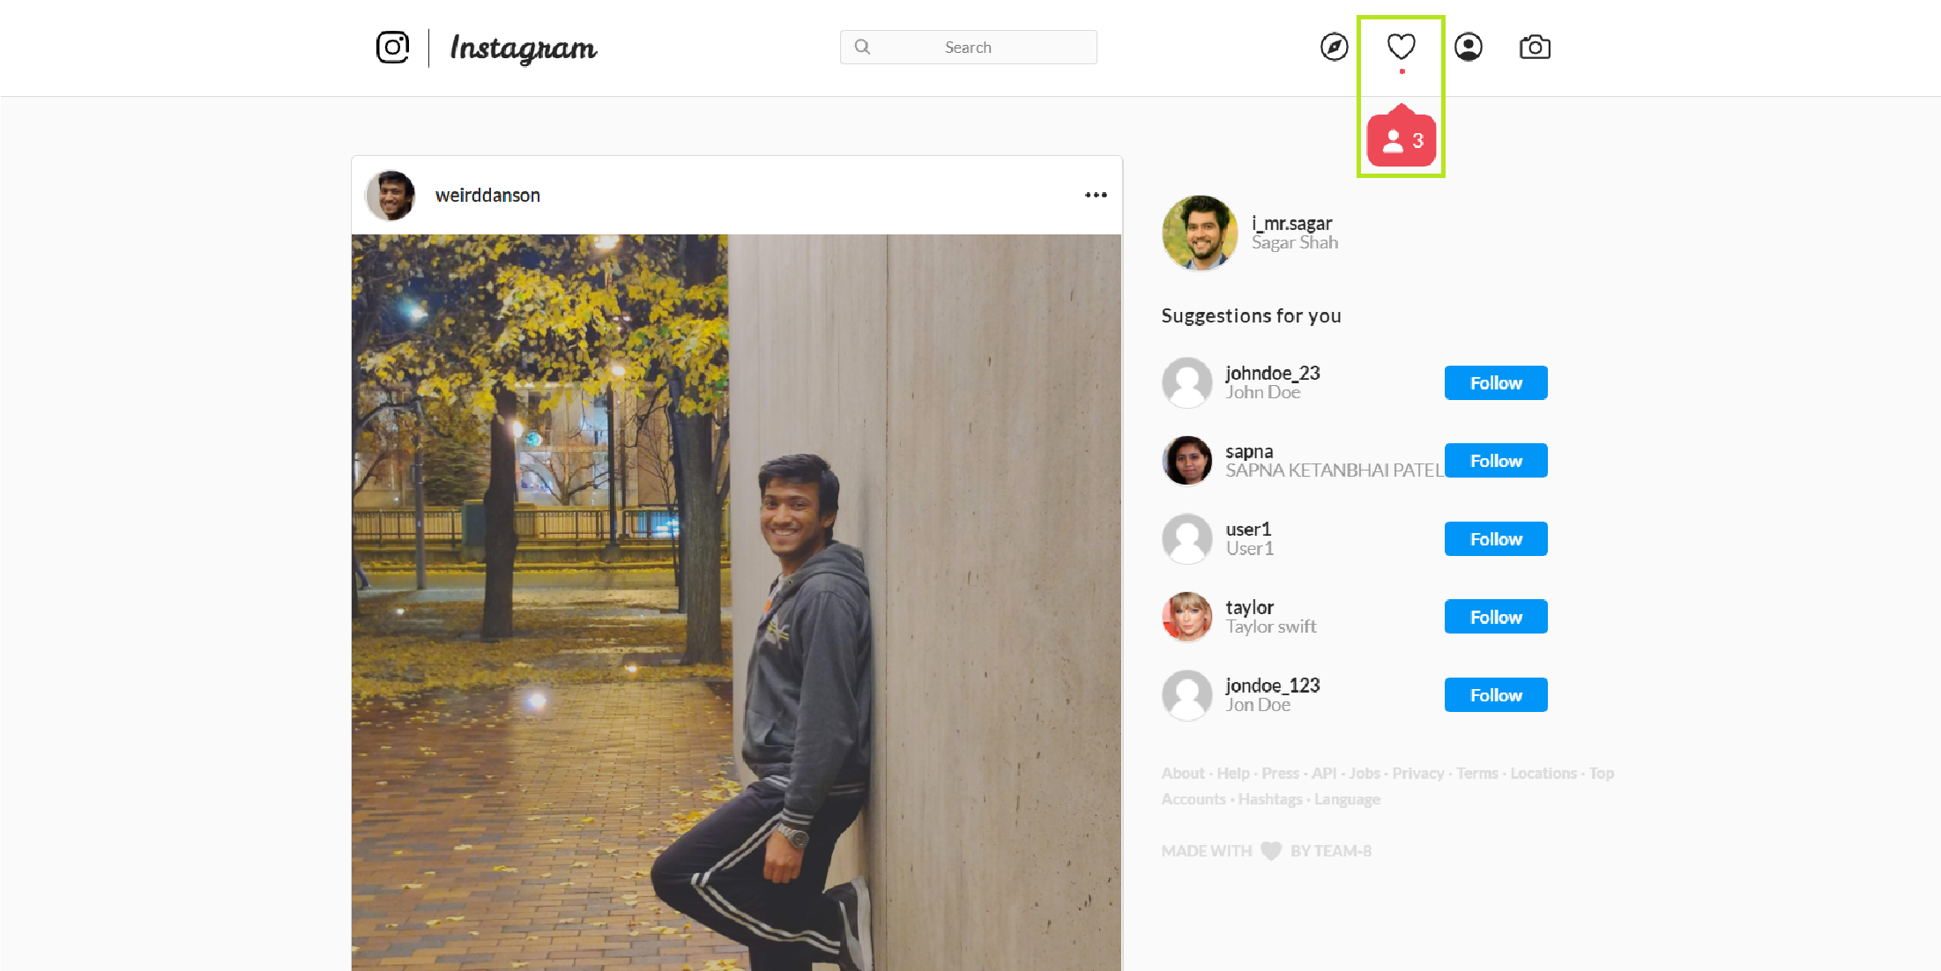
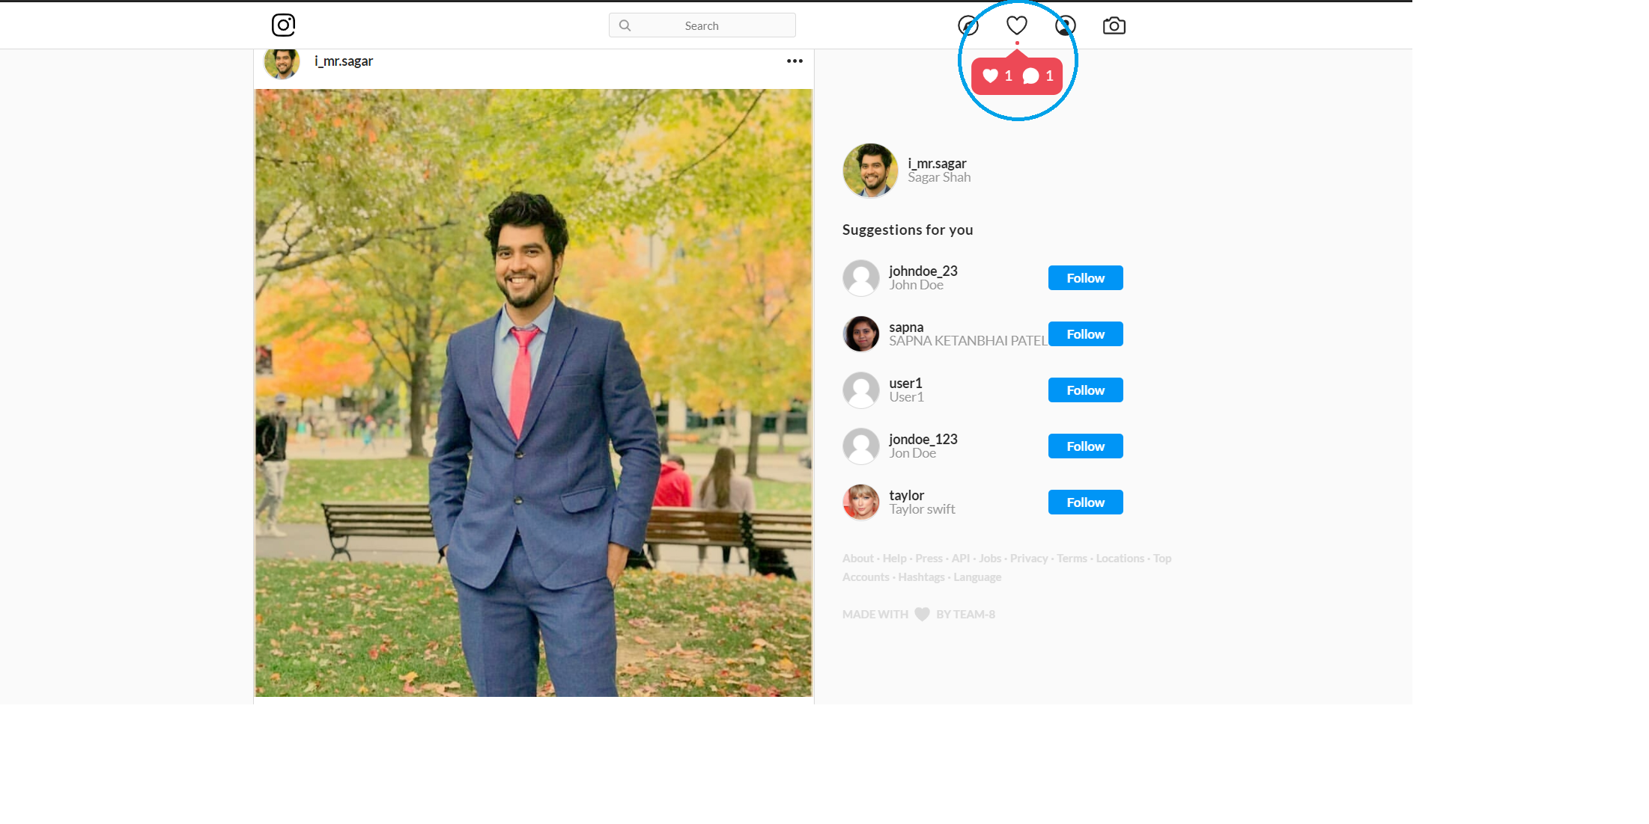
Instagram notifications on notification bar
Implemented real-time notification features for like, comments and followers following in the Instagram Notification bar.
New like and comment
New follower

Slide 12
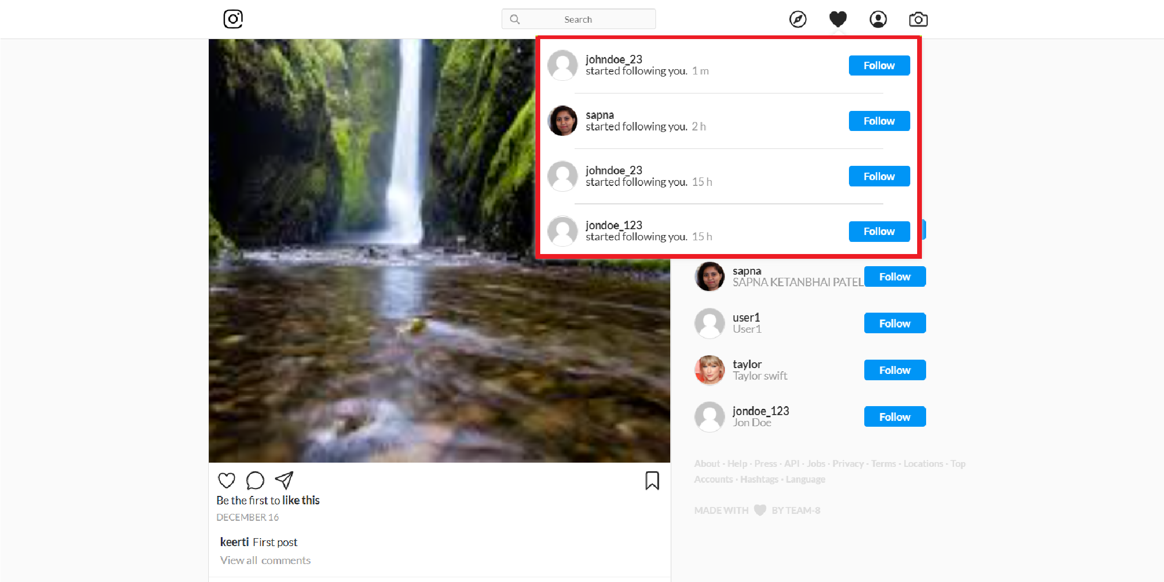
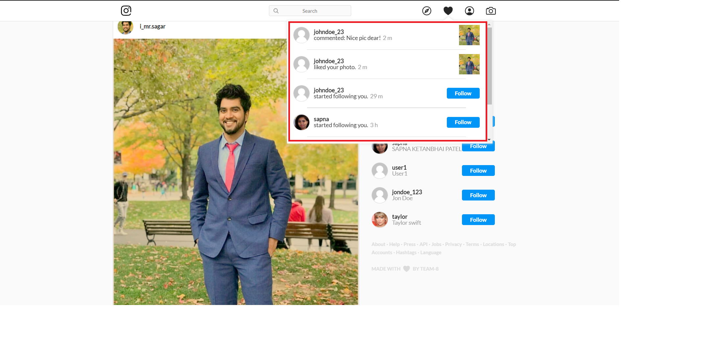
Displaying recent likes, comments, followers as notifications
Notification pop-up feature configured to notify users using the Redux state
Management regarding new activities in the user profile
Details regarding like, comment, followers

Slide 13
Thank You..!!
Moving to the Demo Presentation....

